Slide 1

New User Seminar

Slide 2
Research Computing New User Seminar
Instructor: Gerardo Hidalgo-Cuellar
Website: www.rc.colorado.edu
Helpdesk: rc-help@colorado.edu
Slides: https://github.com/ResearchComputing/New_User_Seminar
Survey: http://tinyurl.com/curc-survey18

Slide 3
Learning Goals
What is CU Research Computing (CURC)?
Understand Basic Resources
Getting an account & logging in
Navigate the RC system
Run a job
Help!

Slide 4

Things to Take Note Of
Confusing, ambiguous, highly nuanced concepts
Goal is to avoid common mistakes, pitfalls, and frustrations
Ask Questions!

Slide 5




CU Research Computing provides
Large-scale, beyond-the-desktop computing resources for the University of Colorado and more!

Slide 6


Resources include:
High Performance Computing
Storage of Research Data
High-Speed Data Transfer
Data Sharing
Cloud Computing
Training & Education

Slide 7
Primarily known for:
High Performance Computing (HPC)

Slide 8

High Performance Computing (HPC)

Slide 9
High Performance Computing (HPC)

Slide 10

High Performance Computing (HPC)

Slide 11
High Performance Computing (HPC)

Slide 12
What would I use HPC for?
Solving large problems that require more:
Memory than you have on your PC
cores/nodes/power thank you have on your PC
High Performance GPU computing
High memory jobs
Visualization rendering

Slide 13



Slide 14
But if you have others to help...

Slide 15

Job that would take a LONG TIME to run...
BIG Job

Slide 16

You can distribute the job load
BIG Job

Slide 17
Or beak up into smaller jobs
Tiny Job
Tiny Job
Tiny Job

Slide 18
Research Computing Resources

Slide 19
HPC Clusters at CURC
Alpine
Blanca
Summit

Slide 20
NSF-Funded
Shared
450+ Nodes (mostly Intel Xeon Haswell)
24 cores per “shas” (general compute) node
Additional Node types:
10 GPU Nodes (NVIDIA Tesla K80)
5 High Memory Nodes (2TB ram)
20 Intel Xeon Phi nodes
11,400 total cores
Summit

Slide 21
Blanca
Buy-in Cluster
Per user specs and vendor constraints
High priority use on your hardware
Preemptable use to all other nodes
Heterogenous
~223 Compute Nodes
~10 GPU nodes

Slide 22
Storage at CURC
PetaLibrary
Core

Slide 23
PetaLibrary
Core
Included with RC account
/home
/projects
scratch
Paid Service for:
Storage
Archive
Sharing of research data

Slide 24
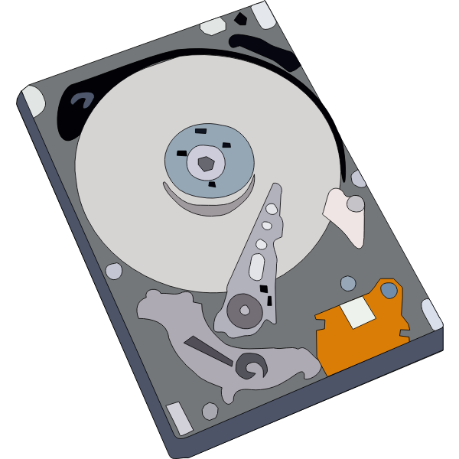

PetaLibrary
Core
Local Storage: your own storage you are welcome to download to at any point

Slide 25
High Speed Data Transfer
High-performance filesystems and node interconnects

Slide 26
Data Sharing: Within RC
Sharing workspaces
Project space
Scratch space
PetaLibrary space

Slide 27
Data Sharing: Outside RC
Globus
Automates large data transfers
Resumes failed transfers
Distributes large transfers across DTNs
Shared endpoints, etc
Data Transfer Nodes (DTN)
Internal CU network
Command line tools
scp, sftp, rsync

Slide 28
Accessing Research Computing

Slide 29
How to Access RC Resources?
Get an account
Set up two factor authentication
(Inform us of any specific needs)
Log in
Create greatness! (responsibly)

Slide 30
Getting an account
CU Boulder users and affiliates:
Request an account through the RC Account request portal
https://rcamp.rc.colorado.edu/accounts/account-request/create/organization
CSU Users:
Request an CSU eID if you don’t have one
Fill out account application form
Duo authentication
Then get an RC user account
https://www.acns.colostate.edu/hpc/summit-get-started/
RMACC Users:
Contact your local representative, if known. Email rc-help@colorado.edu
We’ll guide you through the process

Slide 31
Demo: Getting an Account
CU Boulder users and affiliates:
Request an account through the RC Account request portal
https://rcamp.rc.colorado.edu/accounts/account-request/create/organization

Slide 32
Your RC Account
Access to:
Summit Cluster (soon Alpine)
“Core” storage
PetaLibary Storage (if applicable)
Gateways (CU affiliates)

Slide 33
Two Factor Authentication
Provides an extra level of authentication
We are outside the firewall!
Valuable resources
Inviting, high-profile target
Lost time investigating/fixing
Duo
You will receive a Duo invitation when your RC account is created.

Slide 34
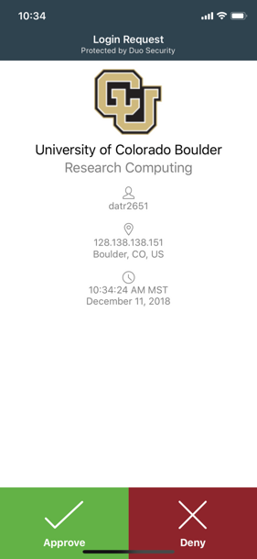
Duo Authentication
Most users use the Duo smartphone app
“Phone Call” is an alternatives
Physical code generator “token” available for $20

Slide 35
Linux comfort level check!
On a scale from (1-10) how familiar/comfortable are you with Linux?
The command line
Basic commands
Linux filesystem
Navigating the filesystem

Slide 36
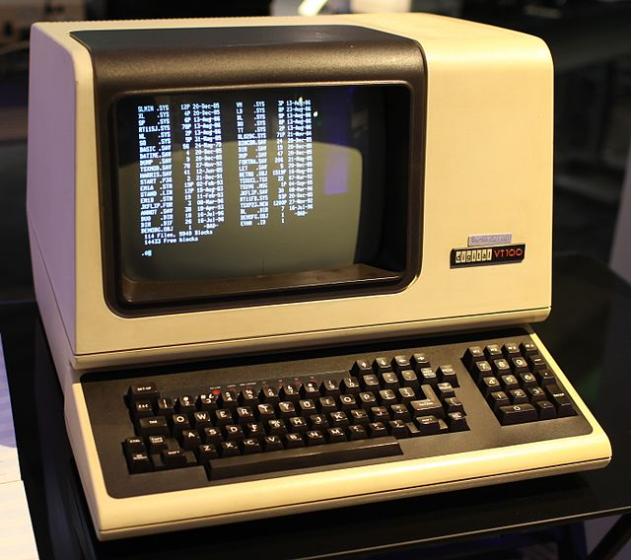
Terminal
Mac or Linux
Terminal application
Windows
PuTTY (recommended)
Powershell
Open OnDemand (alternative for CU affiliates)
For those less familiar with Linux (ondemand.rc.colorado.edu/)

Slide 37
Demo: Logging in via Terminal
To login to an RC login node:
ssh <username>@login.rc.colorado.edu
Supply your IdentiKey password and your Duo app will alert you to confirm the login
If you’re using a tutorial account:
ssh <username>@tlogin1.rc.colorado.edu

Slide 38
Demo: Logging in with OnDemand

Slide 39
Logging In
It’s important to note that you are NOT logging into any specific resource, Summit, etc.
When you log in, you land on our login nodes
From there, you can access our other resources

Slide 40
Navigating Research Computing

Slide 41
Node | File System
One computing server Physical hardware Work together in parallel | The basic tree-like layout From most nodes* you have access to the entire file system
/
d1
d2
d3
d4
f1
f2
Notes:
Nodes are used because there are different needs for hardware - some basic functionality, some very intensive functionality

Slide 42
Node | File System
One computing server Physical hardware Work together in parallel | The basic tree-like layout From most nodes* you have access to the entire file system
/
d1
d2
d3
d4
f1
f2
Notes:
Nodes are used because there are different needs for hardware - some basic functionality, some very intensive functionality

Slide 43
Node Types
Login | Compile | Compute
Where you start For editing code, job submission No heavy computation | Where you compile code, install packages Explore the Summit software environment Edit code, submit jobs No heavy computation | Where scheduled jobs run Intended for heavy computation
Ex. edit job script | Ex. Install python libs | Ex. Running Matlab

Slide 44
Demo: Exploring nodes
Once logged in:
ssh scompile
To log in to a compile (or head) node.
module avail
To check currently available software

Slide 45
File system map
/home/<user>
Node
/
/projects/<user>
/scratch/summit/<user>
/pl

Slide 46
File Structures
/home (2GB) | /projects (250GB) | Scratch (10TB)
Scripts, Code, Small, important files/directories Not for sharing files or job output | Code/files/libraries Software you are installing Sharing files Not for job output | Output from running jobs Large files/datasets Sharing files Not for long term storage
Ex .bashrc | Ex. Shared job scripts | Ex. Data

Slide 47
Demo: Exploring the Filesystem
Once logged in:
cd /home/<user>
cd /projects/<user>
cd /scratch/summit/<user>
To navigate to your different directories

Slide 48
Using Research Computing
We have logged on
We have explored nodes and filesystem
But how do we actually use the computing resources?

Slide 49
Running a Job

Slide 50
The fundamental “job”
What is a “job”?
Work for the cluster to perform on
Batch jobs
Submit job script which will be executed when resources are available
Create script containing information about the job
Submit the job file to a queue
Interactive jobs
Work interactively at the command line of a compute node
Notes:
Cookie analogy** describing a batch job
Limitations of interactive jobs

Slide 51
Job Scheduling
Computer
Hardware
Submit Job
Management
service
Get Results
Storage
Notes:
As a user you want to a) submit a job (analysis to run) then, eventually b) get the results
Behind the scenes things can be broken down into 3 main parts
A management service that help distribute job loads because this is a shared resource
Hardware to actually perform the computation
Storage for software, system information, your data

Slide 52
Job Scheduling
Computer
Hardware
Submit Job
SLURM
Get Results
Storage
Notes:
As a user you want to a) submit a job (analysis to run) then, eventually b) get the results
Behind the scenes things can be broken down into 3 main parts
A management service that help distribute job loads because this is a shared resource
Hardware to actually perform the computation
Storage for software, system information, your data

Slide 53
Your first job
/home/<user>
Where to write it?
How to write it?
How to run it?
/projects/<user>
Scratch space
Notes:
demo

Slide 54
Job Script: 3 main parts
Directives
Specify resource requirements
Software
Because jobs run on a different node than from where you submitted…
…software that is needed must be loaded via the job script
User scripting
the actual user scripting that will execute when the job runs
#!/bin/bash
## Directives
#SBATCH --<resource>=<amount>
## Software
module purge
## User Scripting

Slide 55
Directive Options
http://slurm.schedmd.com/sbatch.html
#SBATCH <options> sbatch <options>
Allocation: --account=<account_no>
Partition: --partition=<partition_name>
Sending emails: --mail-type=<type>
Output file: --output=<file name> (%j gives you job id)
Number of nodes: --nodes=<nodes>
Number of tasks: --ntasks=<processes>
Quality of service: --qos=<qos>
Reservation: --reservation=<name>
Wall time: --time=<wall time>
Job Name: --job-name=<jobname> ...etc...
FYI: You do NOT actually type <> above – this designates something specific you as a user must enter about your job

Slide 56
Writing a Job: Hostname
Submit a slurm job with the following instructions:
The job will be submitted from a bash script named hostname_summit.sh
The job will run on 1 node
We will request 1 minute wall time
Run on the shas-testing partition
Output should contain job id
The job should run the Unix “hostname” command

Slide 57
Writing a Job: Hostname
Set up job boilerplate (nano or vim):
#!/bin/bash
## Directives
#SBATCH --<resource>=<amount>
## Software
module purge
## User Scripting

Slide 58
Writing a Job: Hostname
Directives:
1 node
1 minute wall time
“shas-testing” partition
Output should contain job id
Number of nodes:
--nodes=<nodes>
Wall time:
--time=<wall time>
Partition:
--partition=<partition_name>
Output file:
--output=<file name>
(%j gives you job id)

Slide 59
Writing a Job: Hostname
Software:
Do we need any software? (modules)
User script:
What command do we want to run?

Slide 60
Demo: Writing Hostname

Slide 61
Demo: Writing Hostname
#!/bin/bash
#SBATCH --nodes=1 # Number of requested nodes
#SBATCH --time=0:01:00 # Max wall time
#SBATCH --partition=shas-testing # Specify Summit haswell nodes
#SBATCH --output=hostname_%j.out # Rename standard output file
# purge all existing modules
module purge
hostname

Slide 62
Submitting a Job
Load up the slurm module (default)
module load slurm/summit
Submit the job:
sbatch <script name>.sh
Check output

Slide 63
Review: Learning Goals
Why High Performance Computing (HPC)?
Understand Basic Resources
Get an account & log in
Navigate the RC system
Run a job
Help!

Slide 64
Help! I’m stuck, where do I go?
Documentation: curc.readthedocs.io/
Trainings with Center for Research Data and Digital Scholarship (CRDDS): https://www.colorado.edu/crdds/
Helpdesk: rc-help@colorado.edu

Slide 65
Questions

Slide 66
Survey and feedback
http://tinyurl.com/curc-survey18

